Slide 1







Aqua Gr wth
SOLUTIONS
Notes:
Cover Slide

Slide 2


Pitch
Traditional farming is unpredictable, often wasting water and resources. With Aqua Growth, we’re changing the game.
Our Automated Sprinkler system uses:
Real Time Data
Weather Responsive
Automation
Scalable
Maximize your yields and save money in the process.
Join us into the future of farming

Slide 3

Meet Aqua Growth’s Team
Notes:
Team Introduction
State your Role and your Name

Slide 4
Noah: Project Manager
Microcontroller Operations
3D Printing
Backend Programming
Jeet: Developer
Front End Development
API Integration
Proficient in Python, Kotlin

Slide 5
Jaxon: Developer
Backend Programming
Networking
Proficient in JAVA, Python, and C++
Megan: Developer
Backend Programming
Proficient in Python
Proficient in Kotlin

Slide 6
Daniel: Hardware Tester/Developer
Backend Programming
Networking
Proficient in JAVA, Python, and C++
Alexander: Developer
Backend Programming
Databases
Proficient in JAVA, Python, and Swift

Slide 7



What is our product?
Automated Sprinkler
Our Automated Sprinkler, a smart and user friendly solution designed for California Homeowners and plant enthusiasts is a garden companion that optimizes your plant care routine and automates a healthy growing environment for your houseplants.
Notes:
Software Theme Overview
Mentions target audience
And describes device
In presentation
Talk about the hardware aspect and software aspect.
Hardware -> Talk about the sensors it will connect to.
Software -> Talk about the mobile app via bluetooth or wifi and dashboard.

Slide 8
Hardware
Software
Water Flow Sensor
Moisture Sensor
Microcontroller
3D Custom Case
Wifi / Bluetooth Module
Mobile Application
Digital Dashboard
Connects to Weather
Database
Notes:
I added this slide because I felt that the last slide didn’t highlight the hardware vs software aspect. Do you think I should add this slide into the ppt?

Slide 9

Our goal…
Time & Cost Savings: Our product automates watering, saving you time, and offers detailed analytics for cost savings.
Sustainability: Our product promotes sustainability by mitigating water usage, supporting environmental conservation in the face of climate change and droughts.
Notes:
Team Introduction

Slide 10







Smart Irrigation Market
Key Competitors
Competitor
Strengths | User-friendly interface, smart weather integration, smart home capability. | Budget-friendly, weather integration, remote access. | User-friendly interface, waterproof capabilities.
Weaknesses | Expensive and depends on wifi connection. | No smart home compatibility Complicated Interface. | Limited smart home integration and lack of advanced customization.
Middle-class homeowners
Gardeners
Environmentalist
Market size valued at $1.44 billion in 2020
Expected to reach $5.57 billion in 2030

Slide 11


Unique Value Propositions
Advanced Water Management: Our Automated Sprinkler System offers cutting-edge water management capabilities, allowing you to optimize your garden's watering schedule based on real-time weather data and soil moisture levels.
User Friendly Interface: The Digital Dashboard within the Smart App consolidates vital information all in one place, making it easy for users to monitor and adjust their garden's care settings effortlessly.
Customization and Control: Adjust watering schedules, set preferred moisture levels, and receive push notifications when it's time to water or when rain is expected.
Affordable Sustainability: Our cost-effective solution empowers homeowners and gardeners to contribute to water conservation efforts while enjoying substantial savings on their water bills
Notes:
Introduction

Slide 12
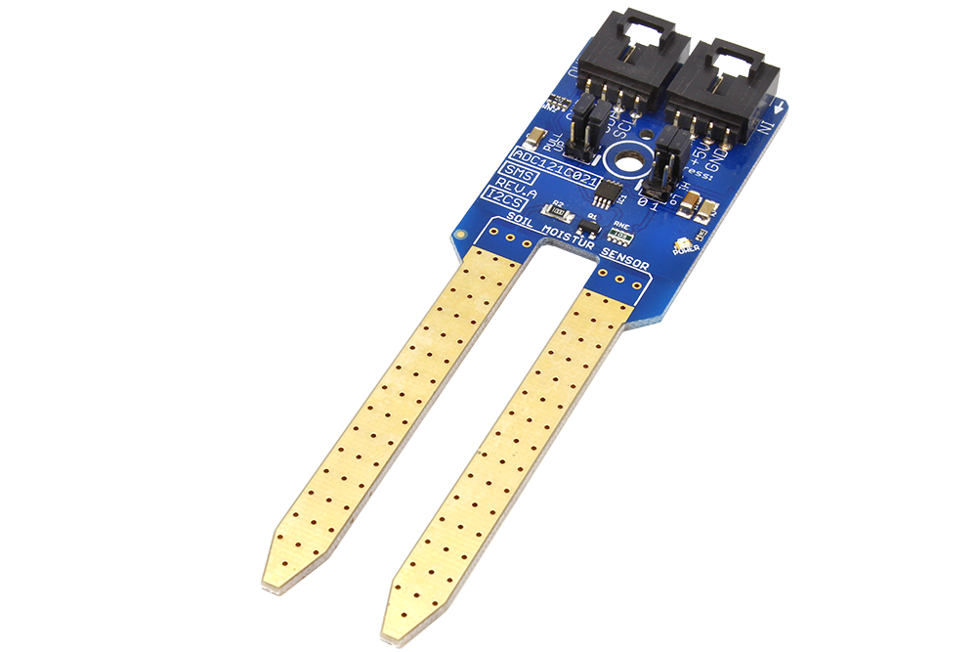
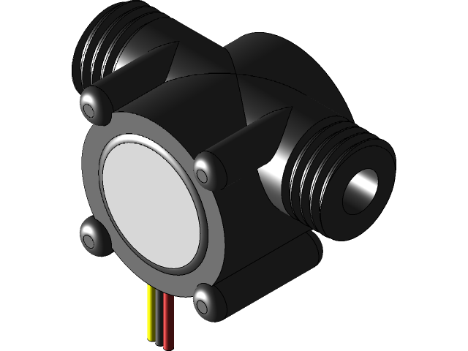
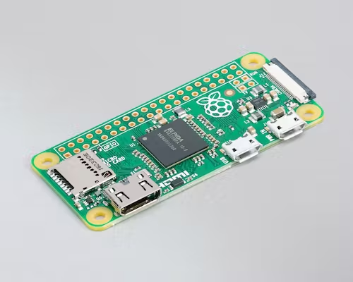



Monetization Strategy
$7
$7
$15
$10
$1
$NA
Soil Moisture Sensor
Water Flow Sensor
Raspberry Pi Zero
Power Supply
Misc (cables)
Casing
$40
$55
30%
Cost Per Unit
Initial one time purchase
Profit Margin
*Customers will have access to the accompanying mobile application to monitor their plants
Notes:
Entrepreneurial Context
Discuss Monetization Strategies

Slide 13

Expected Challenges
Expected Challenges
Sourcing the appropriate parts and materials
The design of the case for the sensor itself
Making it waterproof
Making the data transfer wirelessly
Trying to make the device itself wireless (this might have to much cost)
How will we integrate the moisture sensor
Notes:
Introduction

Slide 14
Potential Strategies
Prototyping Strategy: Our design approach prioritizes extensive prototyping. Fortunately, one of our team members possesses a 3D printer, enabling cost-effective mockup creation.
Comparative Design Analysis: We conduct a comprehensive analysis of existing devices to inform our design decisions.
Iterative Approach: The key to our success hinges on iteration and refinement of our prototypes.
Wireless Data Transfer: We plan to implement wireless data transfer using a microcontroller, although specific implementation details remain under consideration.
Notes:
Introduction

Slide 15

Questions and Answers Session

